Slide 1
Planning Commission Meeting July 5, 2022
Applications before Planning Commission:
Case 1: Multi-Family Development – Eagle’s Landing - Noble Street
Case 2: Rezone (R-2 to C-1) – 163 Viola Avery Street

Slide 2
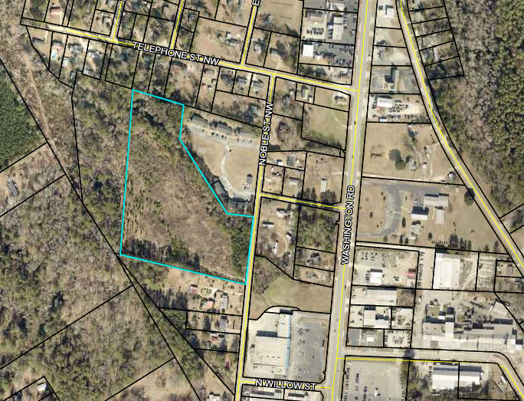
Case 1: Multi-Family Development
Eagle’s Landing

Slide 3
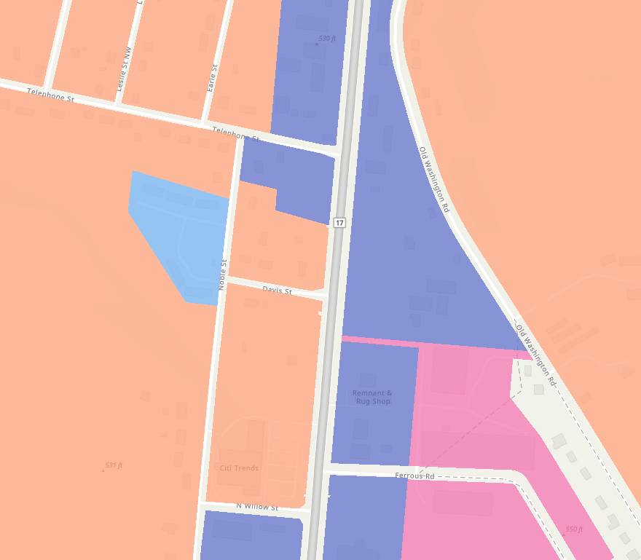
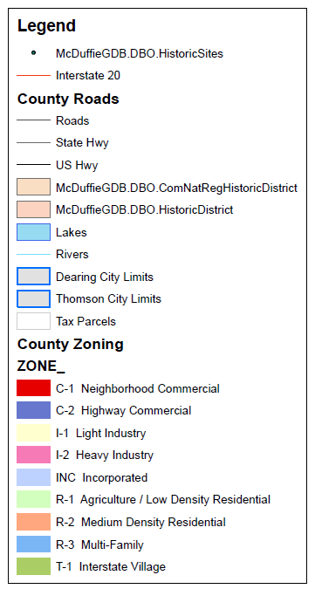
Case 1: Multi-Family Development
Eagle’s Landing

Slide 4
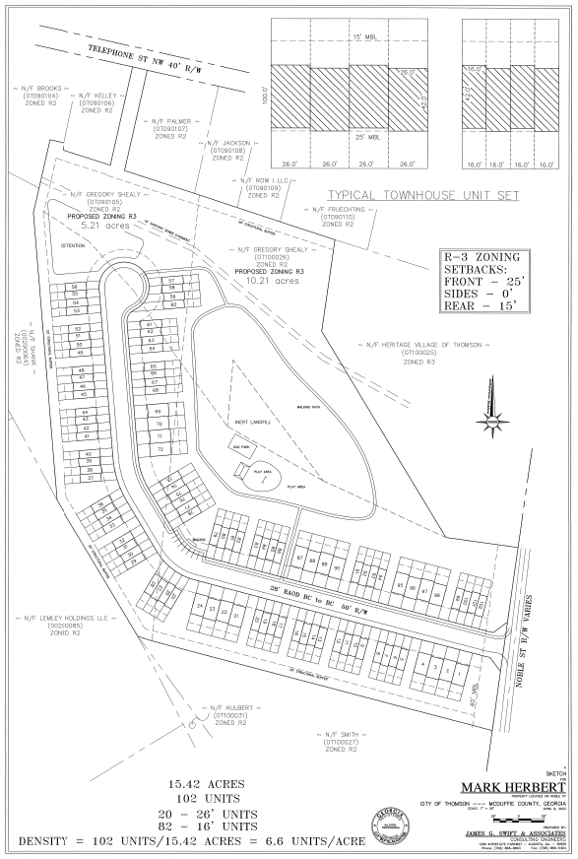

Slide 5
Case 1: Multi-Family Development
Eagle’s Landing

Slide 6
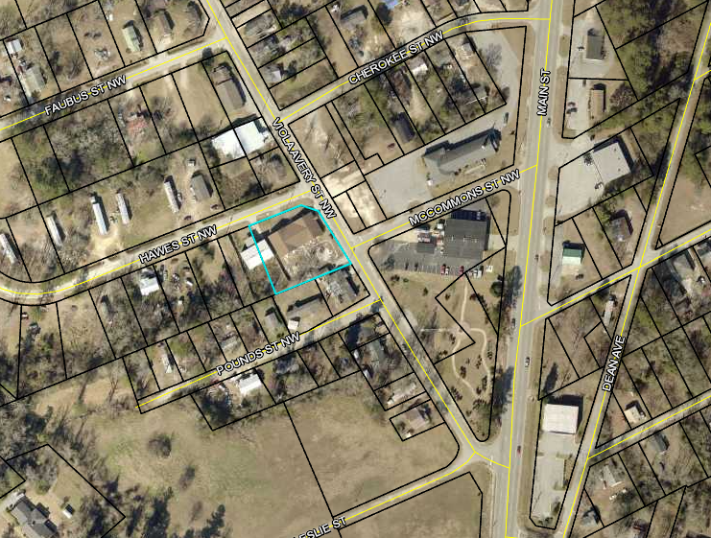
Case 2: Rezone (R-2 to C-1)
163 Viola Avery Street

Slide 7
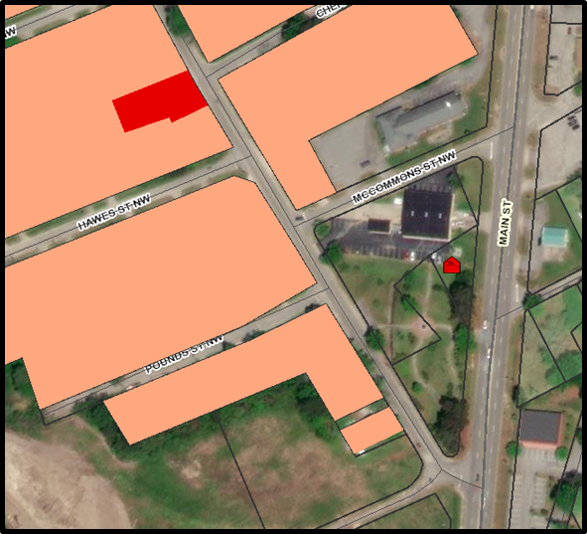
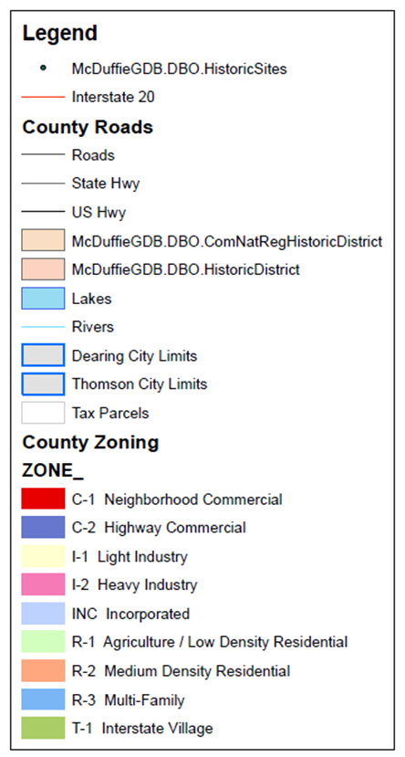
Case 2: Rezone (R-2 to C-1)
163 Viola Avery Street

